Slide 1

KNOWLEDGE INSTITUTE OF TECHNOLOGY, SALEM – 637504
(Autonomous Institution)
MAP
2026
Second Review
Power Weeder for Cocount Farm
Batch No.: 02
Club Name: SMART AUTOMATION CLUB
Team Members: B. Dharaneshwaran, A. Harish, R. Dharaneesh, R. Gokilnathan
Full Affiliation: III Year MECH, Knowledge Institute of Technology. Salem.
Name of the Mentor: Prof K.N. Karthick
Presentation Date: 28.01.2026

Slide 2
Table of Content
Solutions Generated (Customer/Industry Defined Problem)
Final Solution with Key Assumptions
Discussion with Customer /Industry for Solution Fit
Concept Development – MVP
Customer/industry validation
Further Plan to Execute
References

Slide 3
Solutions Generated (Customer/Industry Defined Problem)
Manual weeding causes high labor cost and physical strain.
Work efficiency is low, especially in coconut farms and narrow rows.
Manual hand weeder and electric weeder were studied.
Petrol engine brush cutter was also analyzed.
Gearbox-based rotary blade system showed better performance.
Petrol engine–driven brush cutter with gearbox selected for small & medium farmers.

Slide 4
Final Solution with Key Assumptions
Final Solution:
This project involves the design of a rear-mounted petrol engine brush cutter for weed removal in coconut farms. A 52–63 cc engine provides adequate power, which is transmitted through a bearing-supported shaft to a bevel gearbox for directional change. A rotary blade assembly performs efficient weed cutting, while proper balancing, blade guard, and safety cover ensure safe and stable operation.
Key Assumptions:
Machine is operated by a single person.
Designed for dry and semi-wet soil conditions.
Standard, locally available components are used to reduce cost.

Slide 5
Discussion with Customer /Industry for Solution Fit
Interaction with local farmers and agricultural equipment users revealed:
• Manual weeding causes fatigue and back pain.
• Commercial weeders are too expensive and heavy.
• Requirement for simple design with easy maintenance.
• Preference for petrol engine due to easy availability.

Slide 6
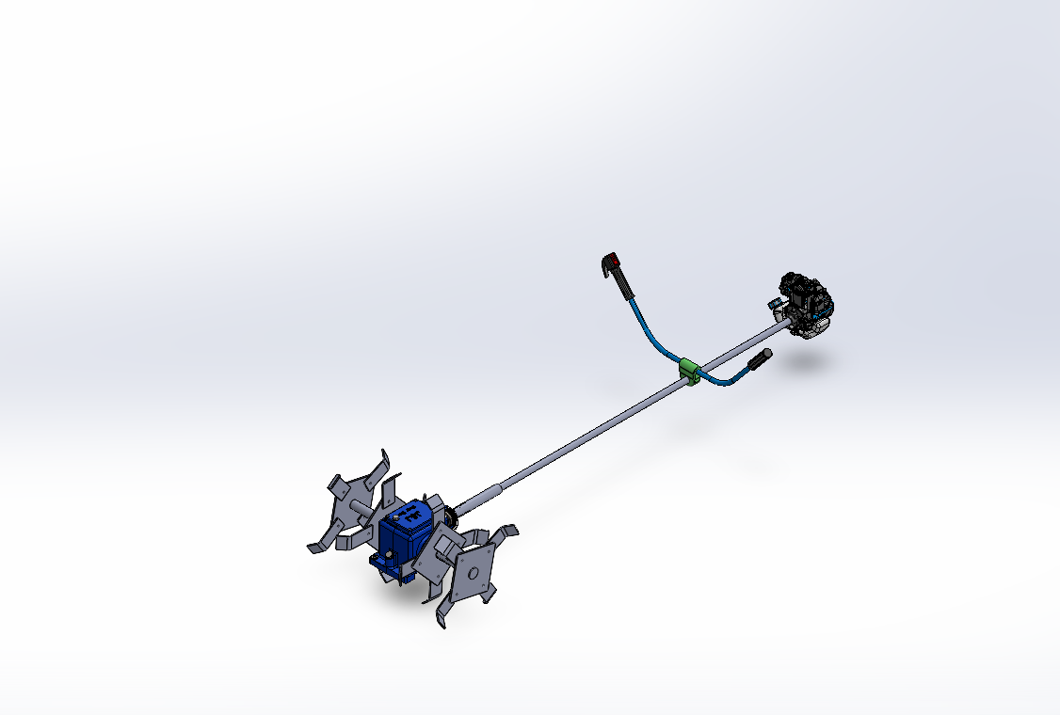
Concept Development – MVP
MVP Features:
Engine mounting frame
Main shaft and bearing supports
Gearbox with blade output shaft
Blade and hub assembly
Protective guard
•

Slide 7
Customer/industry validation
Validation parameters considered:
The concept was shown to:
Farmers
Local mechanics
Validation outcomes:
Design is feasible
Components are locally available
Maintenance is easy
Suitable for small-scale farming

Slide 8
Further Plan to Execute
• Fabrication of full-scale prototype.
• Field testing in real tapioca farms.
• Optimization of blade shape and spacing.
• Cost analysis and weight reduction.
• Incorporation of ergonomic handle design.
• Preparation for final demonstration.

Slide 9
References
Brush Cutter with Rotary Blade Mechanism
https://patents.google.com/patent/US20130269363A1
Agricultural Weeding and Cultivating Tool
https://patents.google.com/patent/US20110083859A1
Motor Operated Brush Cutter for Agriculture
https://patents.google.com/patent/US20080236333A1
Rotary Weeder and Soil Loosening Device
https://patents.google.com/patent/US20140130809A1
Hand-Held Agricultural Brush Cutter Machine
https://patents.google.com/patent/IN201641012345A
Weed Cutting Machine with Gearbox Mechanism
https://patents.google.com/patent/CN104326160A

